Slide 1
R Markdown for Reproducible Research
Overview and examples for data analysis, research, and collaboration
Master Tutorial Presented at the 32nd annual conference of the Society for Industrial and Organizational Psychology
Orlando, FL April 29, 2017
Boris Yanovsky - Facebook
Ryan Derickson - VA National Center for Organization Development

Slide 2
Table of Contents
Learning Objectives
Why R Markdown?
Getting Started
Sample Workflow
Working Examples
Extras and Resources

Slide 3
Learning Objectives
Introduction to Basic Features of R Markdown
Showcase Benefits of R Markdown for Sharing Results and Facilitating Reproducibility
Formatting for Publication with CSS BibTeX

Slide 4
Table of Contents
Learning Objectives
Why R Markdown?
Getting Started
Sample Workflow
Working Examples
Extras and Resources

Slide 5
Why R Markdown?
Communicate effectively with others
Communicate effectively with future-you
Presentation ready results and analysis
Add touch of design and visual appeal to your products
Integrate R with the user interface of RStudio
Notes:
(10 minutes up through here) Ask audience to describe when they’ve had to do something tedious for data analysis. Like resize a table, copy and paste data, make bibliographies, update a graph, and also update the summary and white paper.

Slide 6
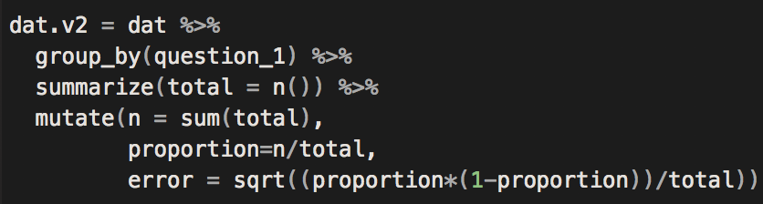
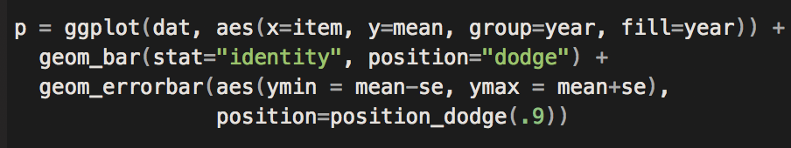
Current Workflow
step 1: write some code…
step 2: write more code…
step 3: get some outputs and graphs…
Now what?
Notes:
5 minutes (15 total)

Slide 7
R Markdown Workflow
HTML Report
Notes:
5 minutes (20 total)

Slide 8
Reproducible Research
Reproducible (read: accountable) research
Facilitates culture of transparency
Knowledge sharing
Current problems:
Replication crisis
Fabricated studies (Science Magazine example)
Strongly encouraged across many disciplines
Center of Open Science

Slide 9
Table of Contents
Learning Objectives
Why R Markdown?
Getting Started
Sample Workflow
Working Examples
Extras and Resources

Slide 10
Getting Started
From Wikipedia:
“Markdown is a lightweight markup language with plain text formatting syntax designed so that it can be converted to HTML and many other formats…”
You may have already used it – or come in contact with it
Blogs
Rstudio : New File : R Markdown…

Slide 11
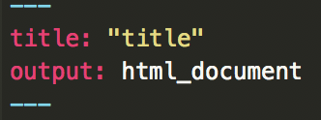
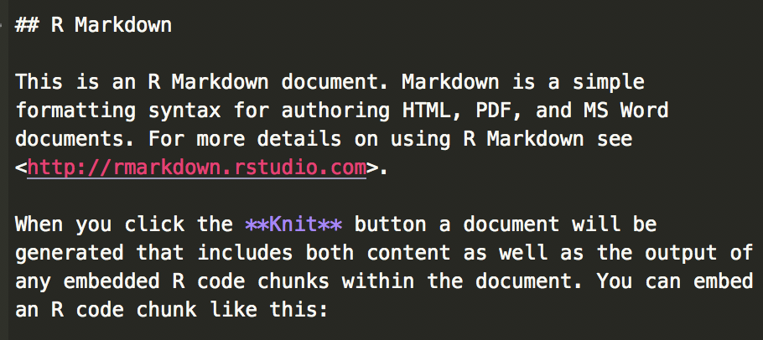
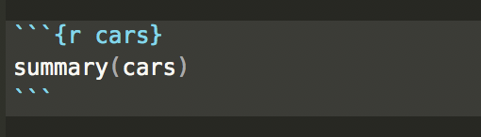
Structure Overview
Heading
Code Chunk
Body
Notes:
25 total

Slide 12
Body Formatting
# Header 1
## Header 2
…etc for headers
*italics*
**bold**
[link](url)
$equation$
more here (R markdown cheat sheet)
Notes:
30 total

Slide 13
Code Control
Flexibility of R code execution and display
warning = (T/F): suppress any warnings from final output
message = (T/F): similar to warning
include = (T/F): include chunk output in final document?
echo = (T/F): include R source code from chunk in document?
eval = (T/F): whether to execute/evaluate R code in the chunk
more found here and in cheat sheet
Notes:
35 total

Slide 14
Exercise #1
Generate a Markdown document and experiment with the following:
Edit code blocks and text fields with your own content
Try variations in formatting (bold, hyperlink, etc.)
Experiment with code control options such as code suppression
Notes:
10 minutes (45 total)

Slide 15
Table of Contents
Learning Objectives
Why R Markdown?
Getting Started
Sample Workflow
Working Examples
Extras and Resources

Slide 16
Sample Workflow
Option 1: Migrate Clean Code to Markdown
Perform data cleaning and exploring in separate R script
Cut/paste main flow of analysis into Markdown document
Add commentary and compile to generate report
Option 2: Work Exclusively in Markdown
Perform all data cleaning in Markdown code chunks
Execute code snippets with highlight/run (cmd+enter) process
Compile to generate report
Notes:
5 minutes (40 total)

Slide 17
Table of Contents
Learning Objectives
Why R Markdown?
Getting Started
Sample Workflow
Working Examples
Extras and Resources

Slide 18
Collaborative Research Project
Example 1
Working with a dataset and conducting reproducible research
Documents with full code available on Github page
To follow along: File → New Project → Version Control → Git
Enter https://github.com/yanovskyb/siop as repository URL
Notes:
10 minutes (~55 total)

Slide 19
APA Publication Ready Manuscript
Example 2
Combining data analysis and manuscript production
Documents with full code available on Github page
Notes:
10 minutes (65 total)

Slide 20
Exercise #2
Update our collaborative research project with new analyses
Pull or download the R Markdown source file from Github page
File → New Project → Version Control → Git
Enter https://github.com/yanovskyb/siop as repository URL
Update the research with a new analysis, data, or any other content
Produce updated document for distribution
Notes:
Optional (time and wifi dependant)

Slide 21
Table of Contents
Learning Objectives
Why R Markdown?
Getting Started
Sample Workflow
Working Examples
Extras and Resources

Slide 22
Extras
Tables
Table of contents
Citations and references
Custom Style Sheet (CSS) formatting
Interactive visualizations
Interactive applications and data dashboards with Shiny
Create Word, PDF, and presentation slides
Multiple document looping
Some examples for inspiration
NYT Interactive visualizations
Shiny links

Slide 23
Resources
R Markdown in Rstudio: http://rmarkdown.rstudio.com/
R Markdown Cheat Sheet
Useful packages:
knitr, rmarkdown, dplyr, ggplot2, reshape2
+ other Tidyverse R packages: http://tidyverse.org/
Really anything by Hadley Whickham
#rstats on Twitter
Notes:
75 total minutes with 15 for questions

Slide 24
Thank You
Contact
Boris Yanovsky borisy@fb.com
Ryan Derickson ryan.derickson@va.gov

